Slide 1







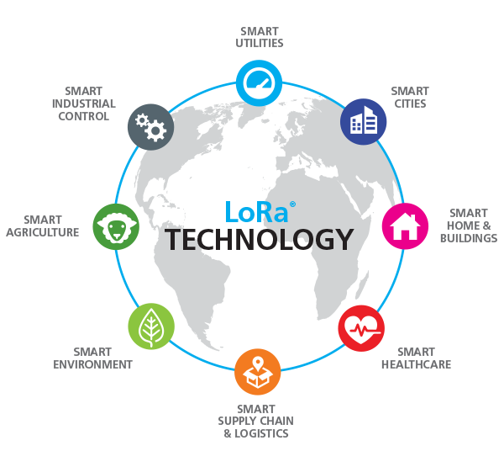
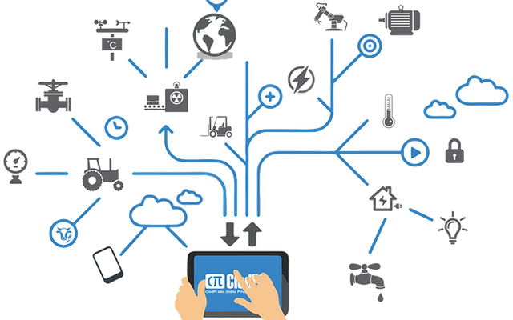
Team and Problem Statement Information
AI ML
Automation
Ministry/Organization : Ministry of Jal-shakti | PS Code: SIH1293
Problem Statement:
LoRa
Automatic regulation of valves for release of water based upon soil moisture availability in the root zone of the crop, using artificial intelligence, in a piped and micro irrigation network of irrigation system.
Institute Name: SCTR’s Pune Institute of Computer Technology, Pune.
Institute Code (AISHE): C-42072
Theme Name: Smart Agriculture
Team Name: Team Yantra
Team Leader Name: Raj Dusane.
IOT
Real time monitoring

Slide 2
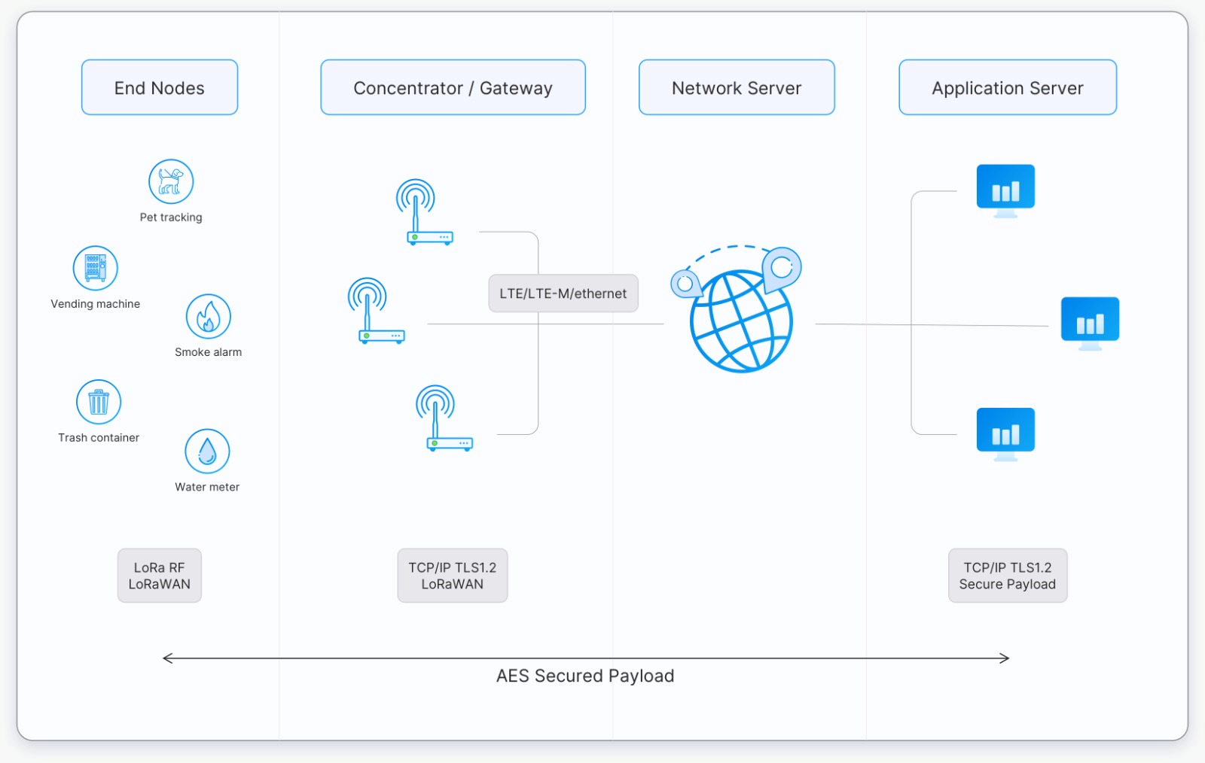
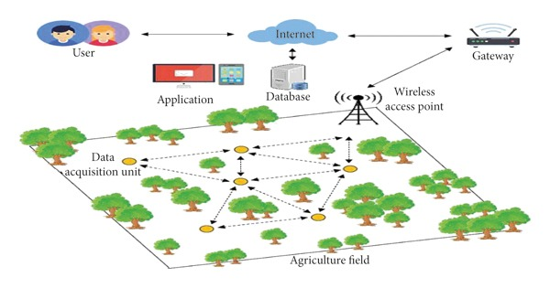
Proposed Solution
# Transmitter side
AT-Mega 328P (micro-controller)
LoRa module
# Sensors
Barometric Pressure Sensor
(air pressure measurement)
Humidity sensor
Temperature sensor
Soil Moisture.
Anemometer Sensor (wind speed measurement)
# Gateway unit
Arduino 328P/ Esp 32/86
2. LoRa Module SX1278

Slide 3
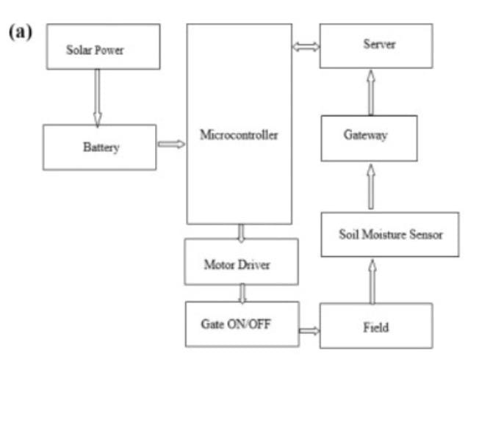
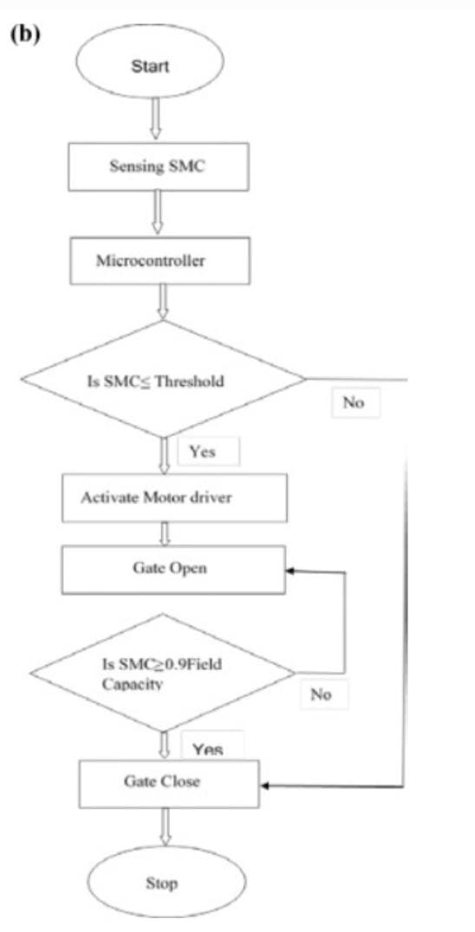
Block Diagram And Flow-Chart

Slide 4
Technologies Used
Automation
AI ML
LoRa
IOT
Real time monitoring

Slide 5
